Slide 1
PROJECT
APPLE QUALITY
PREDICTION

Slide 2
CONTENT
Problem Statement
Objective
Tools Used
Data Summary
Exploratory Data Analysis
Training
.Conclusions

Slide 3
PROBLEM STATEMENT
Develop a predictive model to assess the quality of apples based on their size, weight, and sweetness levels. The aim is to develop a scalable solution that not only accurately assesses the overall quality of individual apples but also provides insights into broader trends within apple batches. This predictive model will empower stakeholders across the supply chain, including growers, distributors, and retailers, to optimize decision-making processes related to harvesting, sorting, and marketing, ultimately enhancing consumer satisfaction and market competitiveness within the apple industry.

Slide 4
OBJECTIVE
The objective is to create a robust algorithm that accurately determines the overall quality of apples using these measurable attributes, enabling stakeholders in the apple industry to efficiently sort and distribute produce according to quality standards

Slide 5
Tools Used
Jupyter Notebook is used as IDE.
Pandas and NumPy are used for Data Manipulation & Pre-processing and Mathematical functions respectively.
Exploratory data analysis is automated by data prep.
For visualization of the plots, Matplotlib, Seaborn, Plotty are used.
GitHub is used as version control system

Slide 6
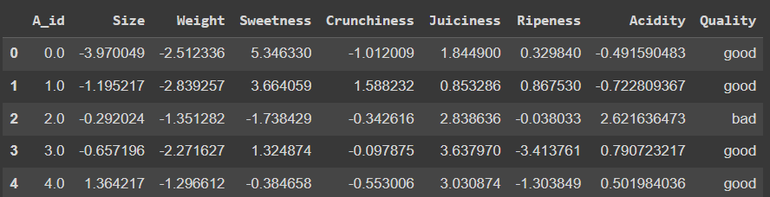
DATA SUMMARY

Slide 7
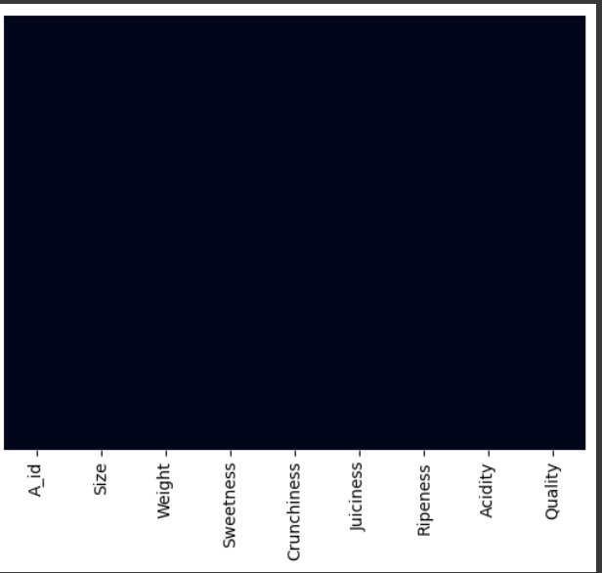
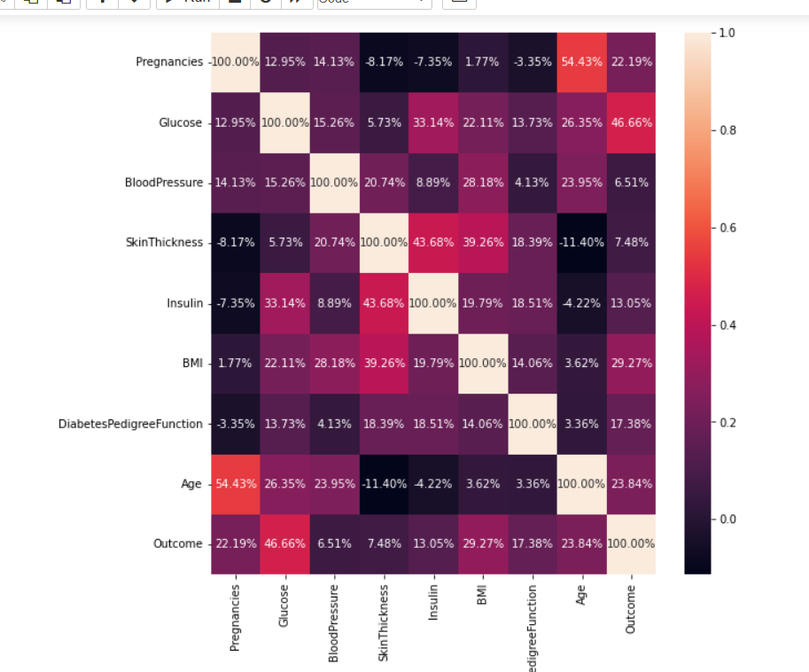
CORELATION BETWEEN COLUMNS
This graph shows how many null values are present the dataset for each column.
.
.

Slide 8
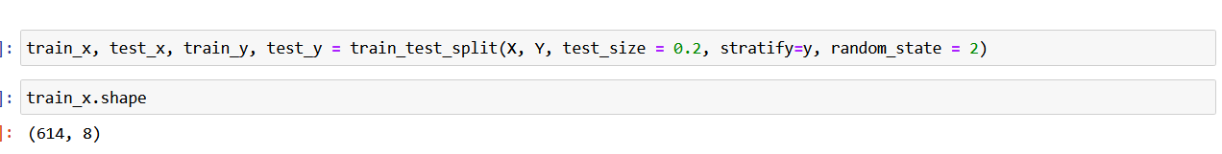
TRAINING DATA BY SPLITTING
This code snippet, the train_test_split function from scikit-learn is used to split the dataset (X and Y) into training and testing sets (train_x, test_x, train_y, test_y). The testing set comprises 20% of the original data, with class proportions maintained (stratify=y), and a random seed of 2 is set for reproducibility.

Slide 9
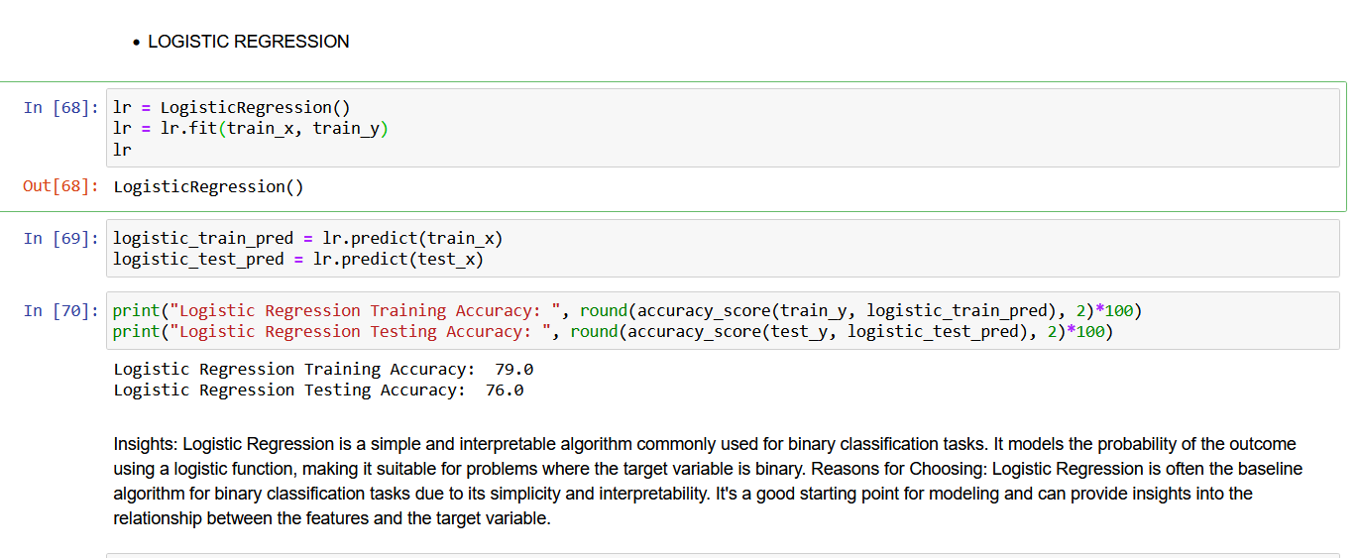
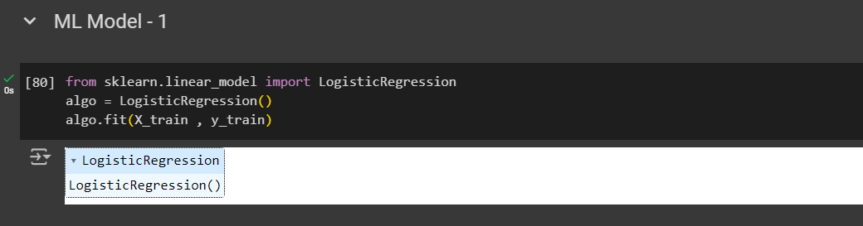
LOGISTIC REGRESSION
It is used for classification model only.This code snippet utilizes a trained logistic regression model (lr) to make predictions on both the training and testing datasets. The "algo.fit" method is used to train the model on a given dataset.
.

Slide 10
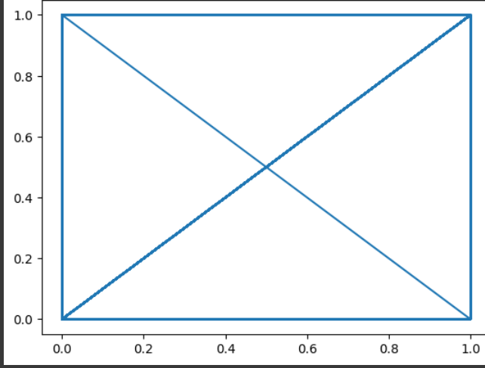
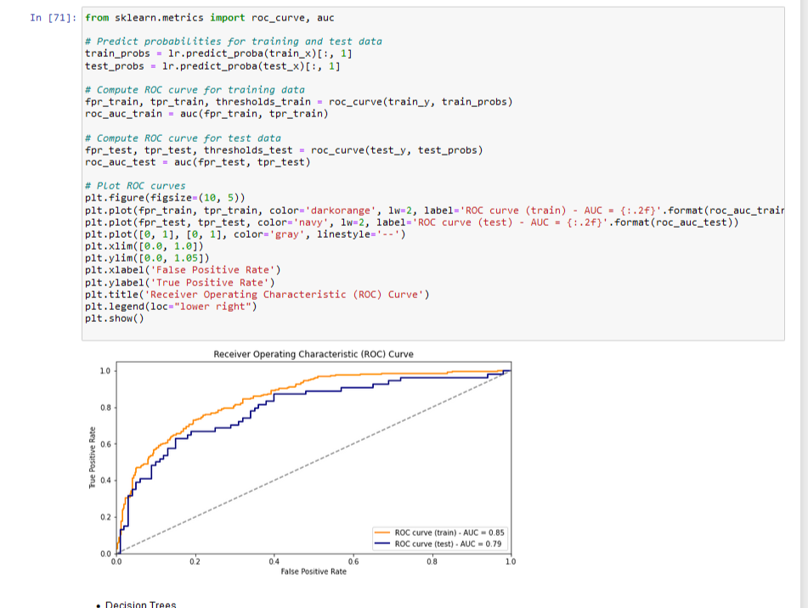
METRIC SCORE CHART(logistic regression)
The code plots predicted values against actual values for the training set. It aims to visualize how closely the model's predictions align with the actual data points. A diagonal line would indicate perfect alignment between predicted and actual values. However, scatter plots are commonly preferred for such visualizations in regression tasks. Additionally, it's essential to assess the model's performance on unseen data and consider other evaluation metrics for a comprehensive analysis.

Slide 11
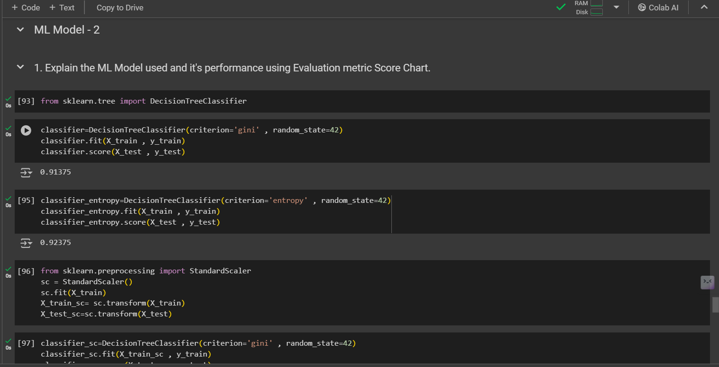
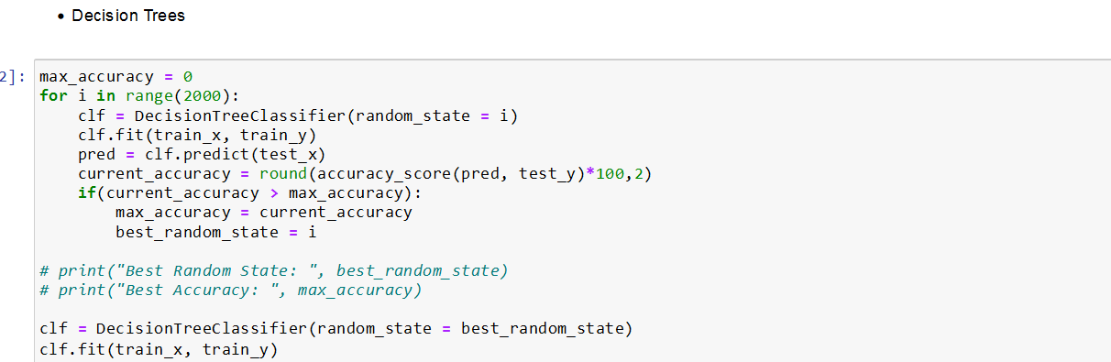
DECISION TREE
This code snippet performs classification tasks using decision tree classifiers before and after standardizing the input features. Initially, a DecisionTreeClassifier is initialized with the 'gini' criterion and trained on the provided training data. Its accuracy score on the test data is then computed to evaluate its performance. Subsequently, the input features are standardized using StandardScaler to ensure that all features are on a similar scale. Another DecisionTreeClassifier is then initialized with the 'entropy' criterion and trained on the standardized training data. The purpose of standardization is to prevent features with larger scales from dominating model training, as decision trees are sensitive to feature scales. By comparing the performance of both classifiers, one with standardization and one without, the code aims to observe potential improvements facilitated by standardization. While accuracy score is used for evaluation here, other metrics like precision, recall, and F1-score could provide additional insights, especially for imbalanced datasets.

Slide 12
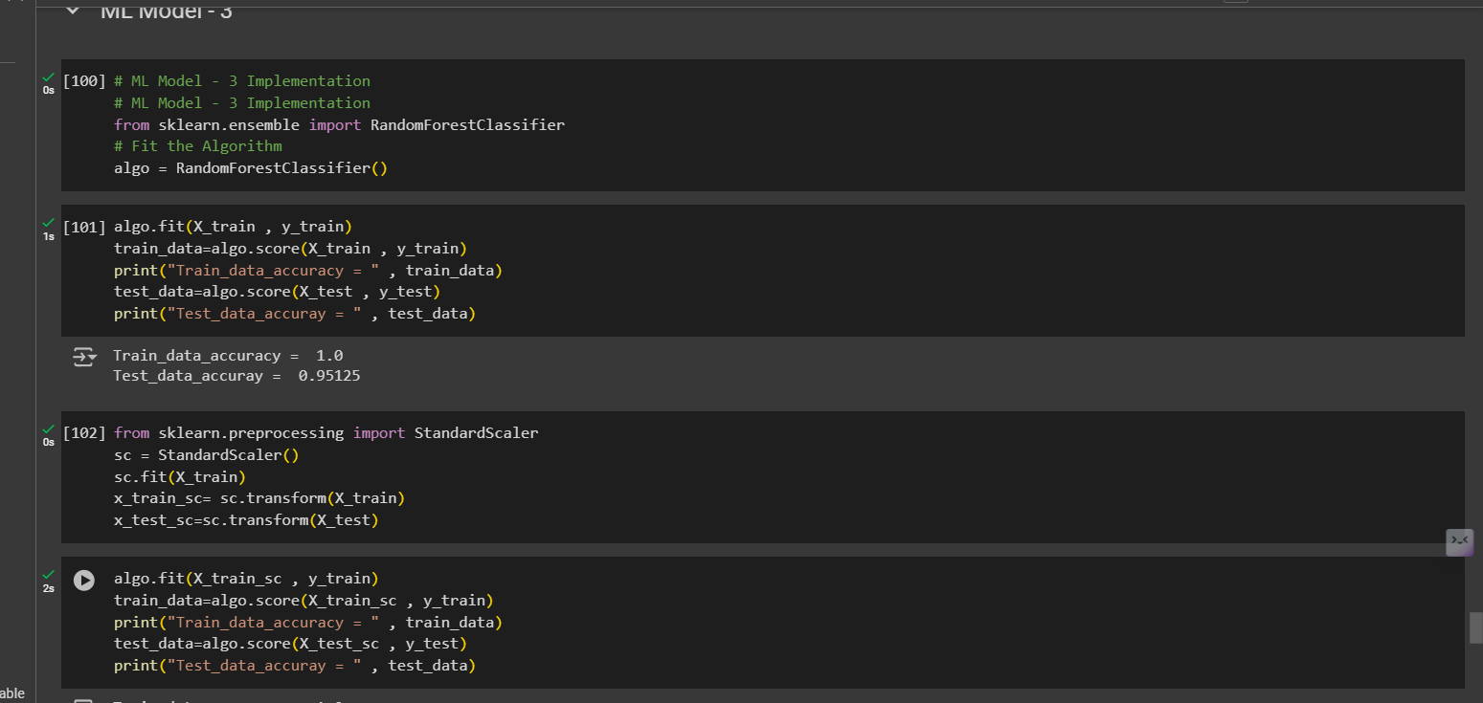
RANDOM FOREST ALGORITHM
Random Forest algorithm offers a multitude of advantages across diverse machine learning applications. Its ensemble nature combines the predictive power of multiple decision trees, resulting in superior accuracy and robustness compared to individual trees. One of its prominent benefits lies in its resistance to overfitting, making it suitable for handling noisy or complex datasets without extensive preprocessing. Moreover, Random Forest excels in versatility, being applicable to a wide range of tasks including classification, regression, and anomaly detection.

Slide 13
Conclusions
Model Performance: Evaluate the performance of different machine learning algorithms (e.g., logistic regression, decision trees, support vector machines) in predicting diabetes using metrics like accuracy, precision, recall, F1 score.
Cross-Validation: Employ techniques like k-fold cross-validation to validate model performance and ensure robustness against overfitting.
Hyperparameter Tuning: Fine-tune model hyperparameters through grid search or randomized search to optimize performance.
Ensemble Methods: Explore ensemble methods such as bagging or boosting to further enhance prediction accuracy and stability.
Interpretability: Ensure model interpretability by using techniques like feature importance analysis to understand the factors driving predictions.

